Slide 1
Winner Winner Chicken Dinner
Gauravdeep Singh Bindra

Slide 2
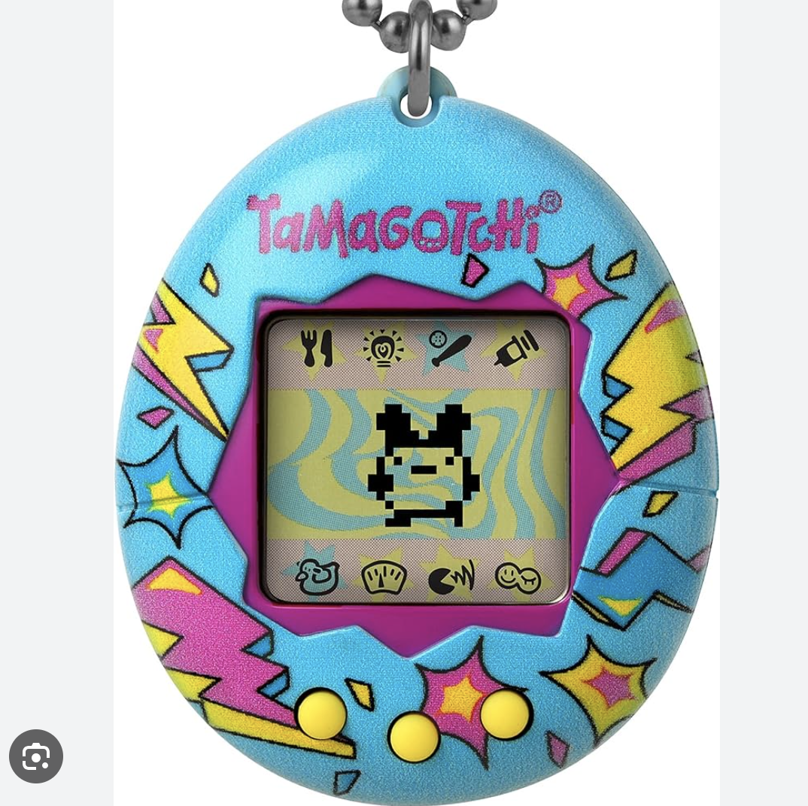
Overview
Web3 game
Users get to interact with and influence the state of the “game”
Inspired by Tamagotchi - digital pet launched in Japan with whom you can interact

Slide 3
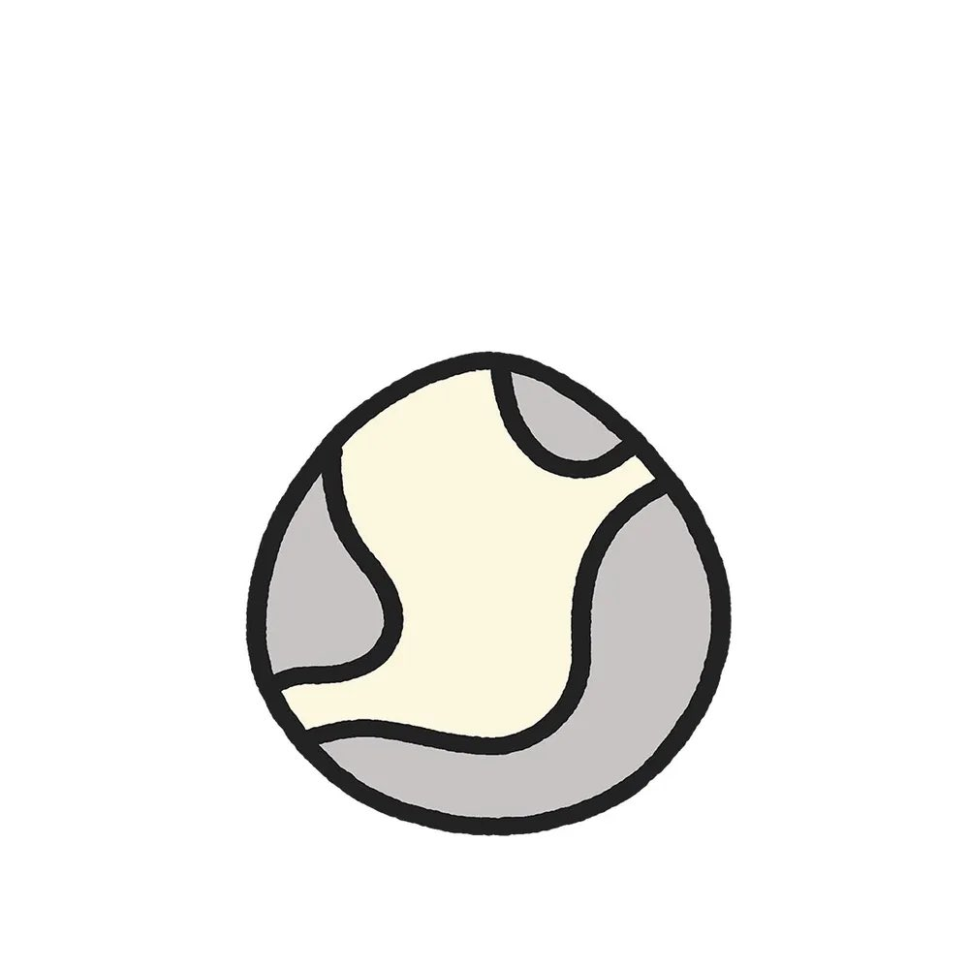


Relevance to Blockchain
Collective “meme” sharing
The status of the game can represent the status of a blockchain project community, crypto prices etc
(Future scope: Build a raffle into it where the odds are determined by the status of the game)
Inspired by Cool Cats NFT project

Slide 4
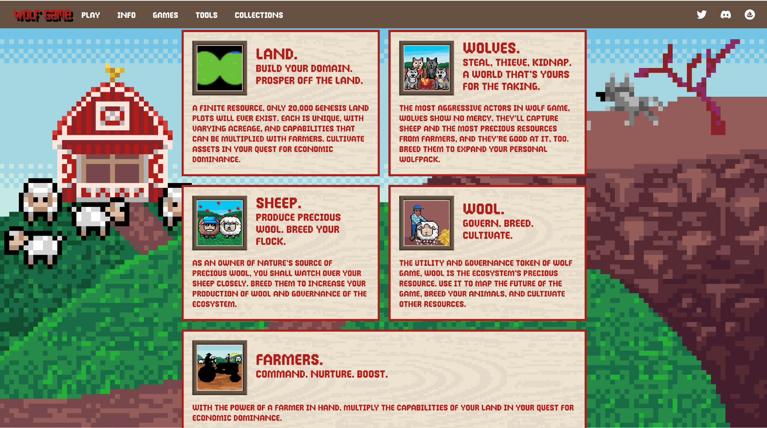
Original IDEA
Build a web3 game that brings together and applies all concepts we learned in class
Staking
NFTs
Randomization
(+game theory)
Inspired by wolfgame
Factions - stake coins - take decisions - prisoners dilemma - levels - winner(s) get all the staked coins
Notes:
Factions - stake coins - take decisions - prisoners dilemma - levels - winner(s) get all the staked coins

Slide 5
OBJECTIVES AND ARCHITECTURE
Deploying the smart contract connected to the front end
Anyone should be able to interact with it
The smart contract controls the state of the game(emoji) that is visible to everyone

Slide 6
FRAMERWORKS USED
Foundry - Ethereum application development toolkit designed for efficiency and speed in smart contract development
Svelte kit - development framework designed to build efficient and fast web applications. Used for Wallet connect

Slide 7
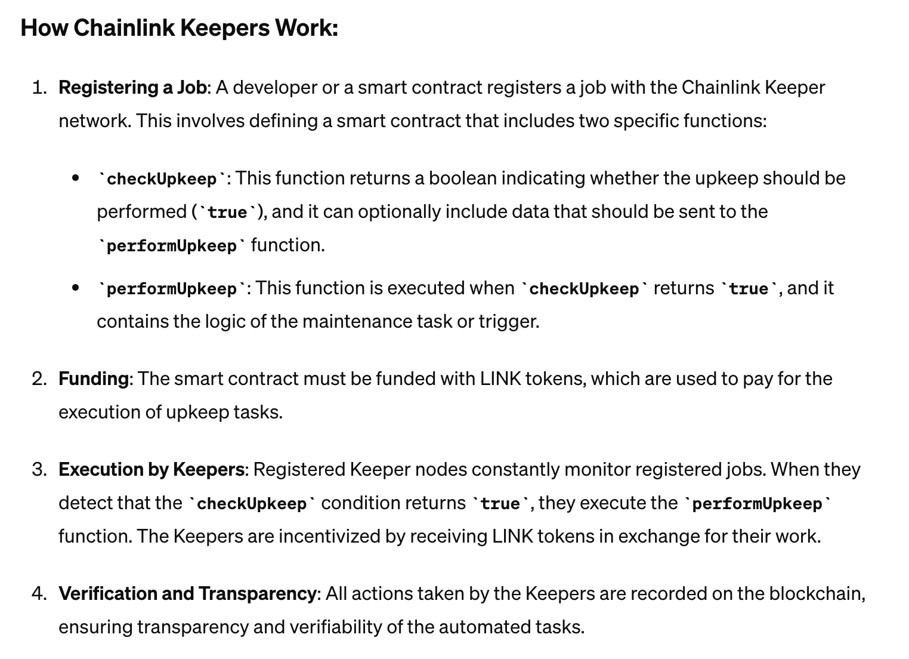
Chainlink keepers
Used Chainlink keepers to keep track of time to automatically reduce the attribute values after a given time. provides a reliable way to automate smart contract triggers and maintenance tasks on the blockchain.
Registered upkeep on chainlink
Upkeeps work with LINK. Got Testnet LINK from LINK faucet.
Explanation of Chainlink Keepers(from ChatGPT)

Slide 8
EMOJI is an SVG file and not an image
Happiness, Hunger, Enrichment - Three attributes. Happiness is based on Hunger and Enrichment scores.
Image - the image is an NFT - on chain - wanted to have it fully on chain - SVG file - base64 from OpenZepplin - browser renders the SVG out since it is base64 encoded. So this is basically a meta game - the NFT is itself the game
The SVG is updated based on : Checked (Time?) - last time, time was checked Checked = block.timestamp - time stamp of the block.

Slide 9
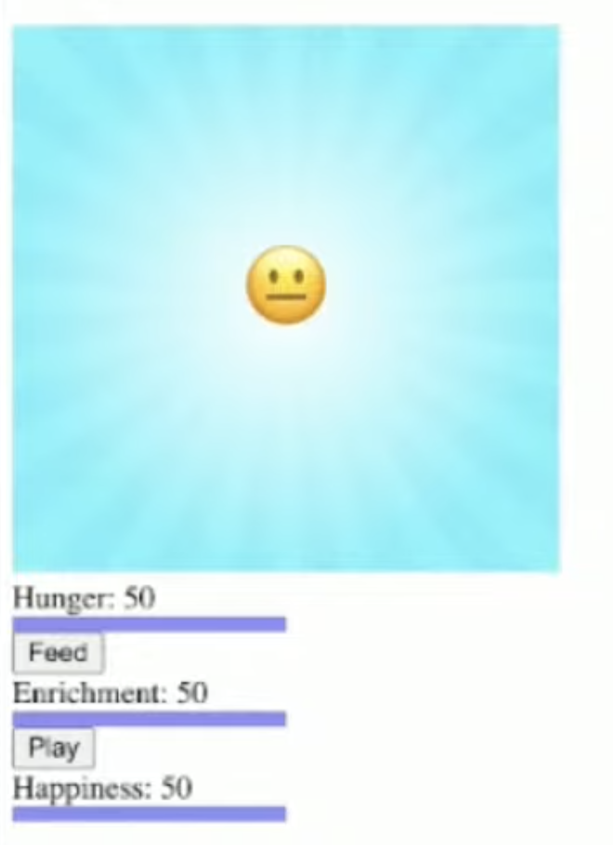
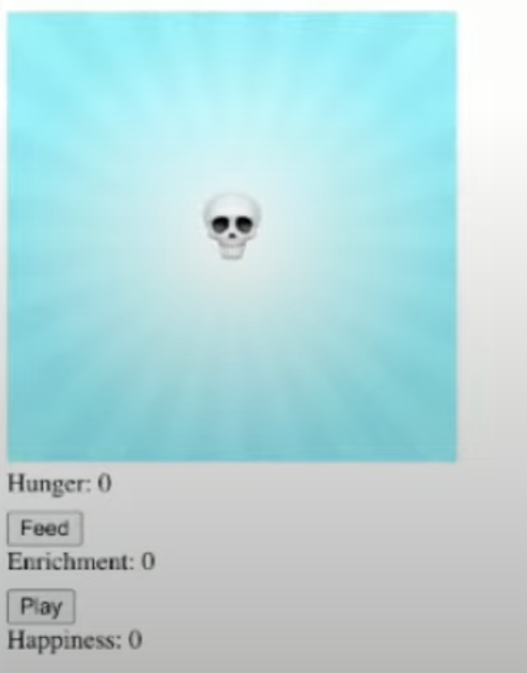
Implementation & Evaluation
Working link: https://drive.google.com/file/d/1SBW0RXvPM_lhWSvUyPz_fDNO0qFBnPxz/view?usp=sharing

Slide 10
Challenges and Lessons
Always work in a team
Since i didnt have experience with coding in Solidity, should have chosen a simpler project from the start and probably one where there are some resources available to refer and get started.

Slide 11
References
Managing upkeep : https://docs.chain.link/chainlink-automation/guides/manage-upkeeps Foundry: https://book.getfoundry.sh/ SvelteKit: https://kit.svelte.dev/

Slide 12
Winner Winner Chicken Dinner - 2 Chainlink betting game

Slide 13
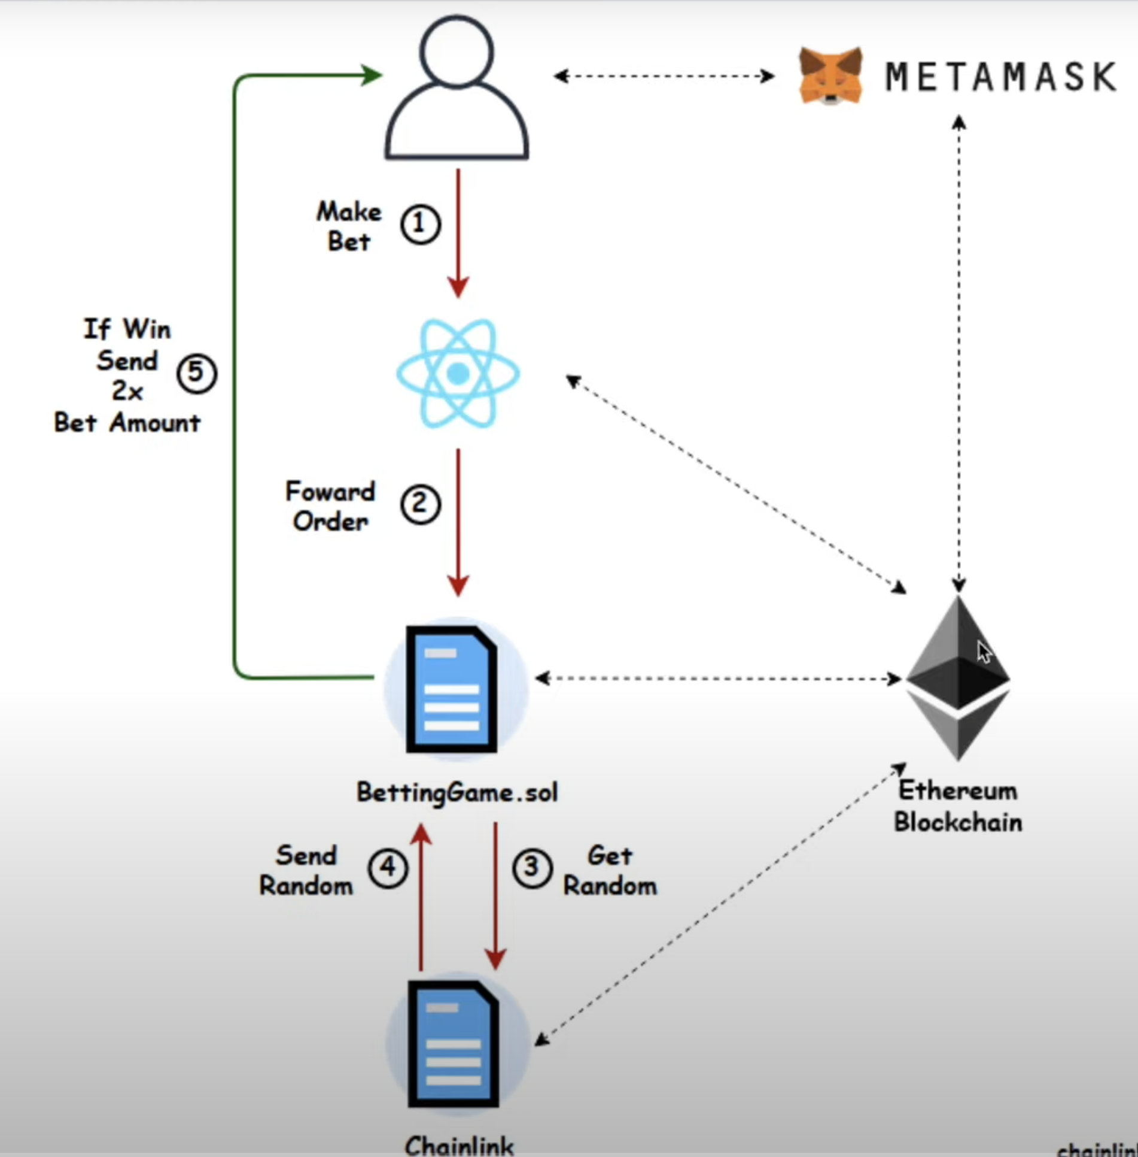
ARCHITECTURE
Main Technology Chainlink Protocol - for randomness of the dice-roll Chainlink is an oracle service We need Chainlink because of the problems with being able to generate random numbers like we discussed in class.

Slide 14
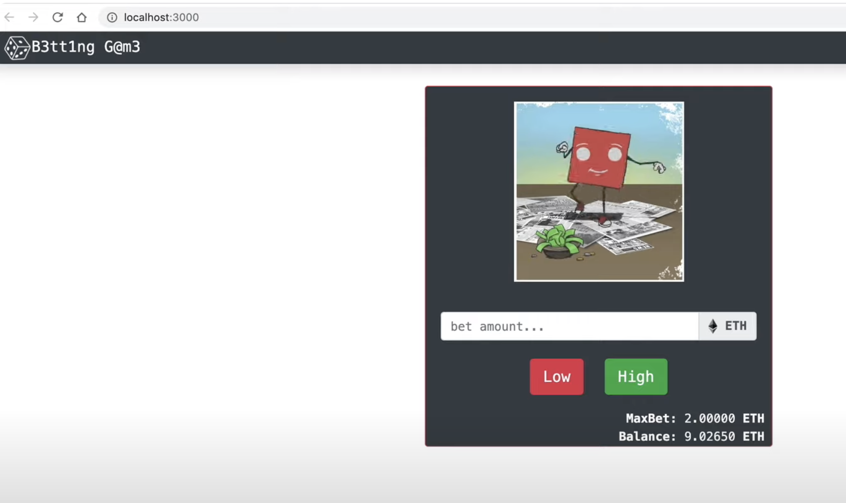
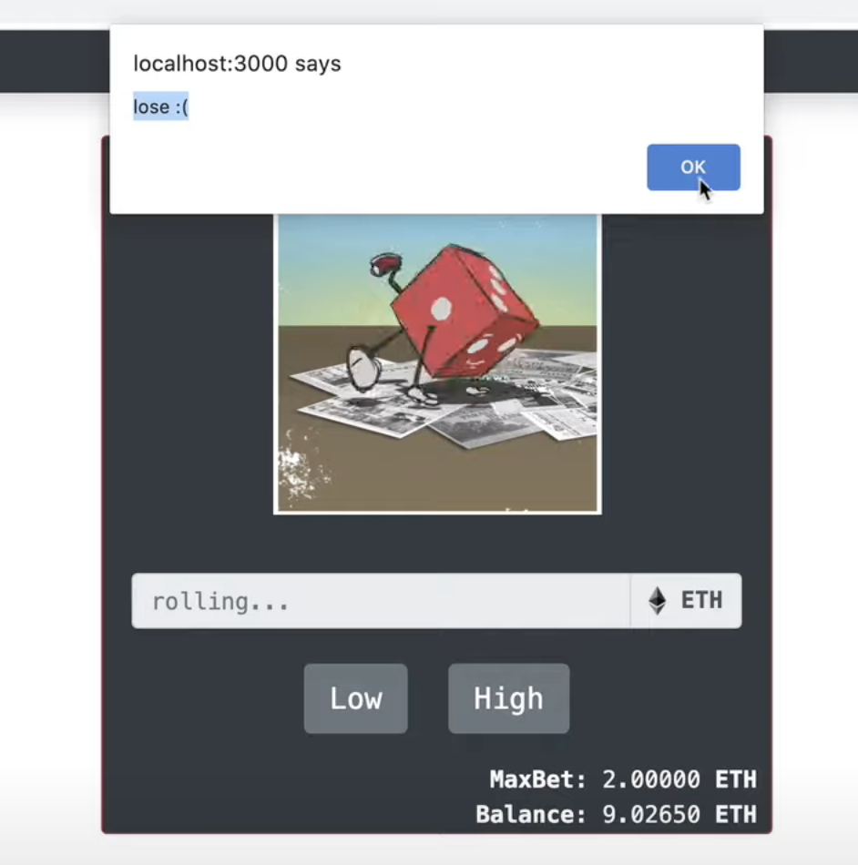
Front-end
This is how the front-end will look. MaxBet is based on the ETH in the smart contact while Balance is the balance in user’s wallet that is connected to the website.
Pop-up showing the result followed by the transaction and account update

Slide 15
Working
Smart contract is loaded with some Sepolia ETH and LINK. Needs LINK to pay to Chainlink smart contract - to provide random number to our smart contract.
The ETH in the SmartContract determines the current max bet amount. Users can bet only in ETH. No other crypto currency supported.
Users can bet on Low/High. Low covers dice roll values(1,2,3) and High covers dice roll values(4,5,6)
If users bet is placed correctly, they get 2X their bet amount back, otherwise they get nothing back. (In a full-fledged application ofcourse they will get <2X because of some margin for the Casino/SmartContract creator.

Slide 16
References
ChainlinkVRF : https://docs.chain.link/vrf/v2/direct-funding https://vrf.chain.link/ Getting a random number on Chainlink: https://docs.chain.link/vrf/v2/subscription/examples/get-a-random-number Sepolia Faucet for chainlink: https://faucets.chain.link/sepolia Chainlink repo and documentation:https://github.com/smartcontractkit/chainlink/blob/develop/contracts/src/v0.8/vrf/VRFConsumerBaseV2.sol

Slide 17
Thanks!

